Slide 1


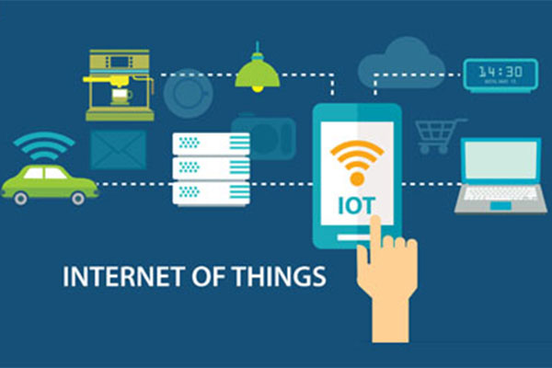
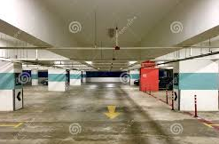
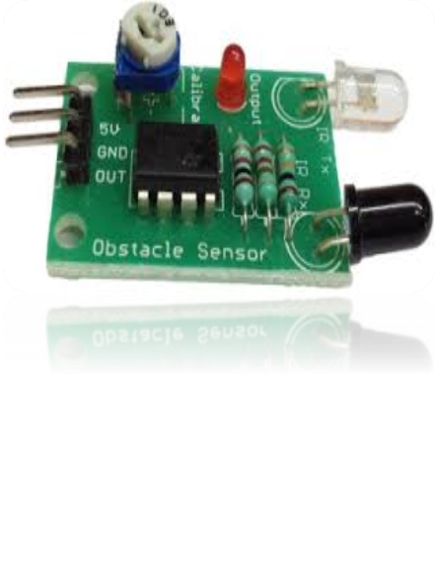
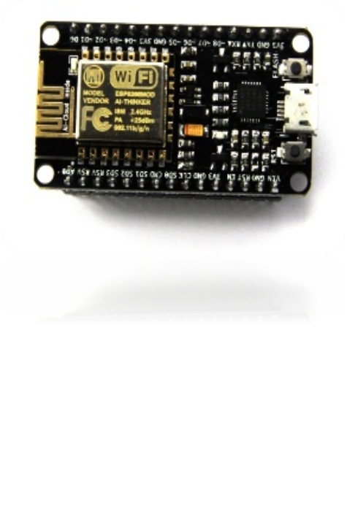
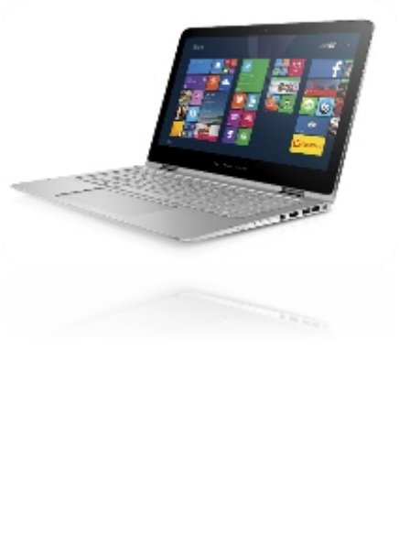
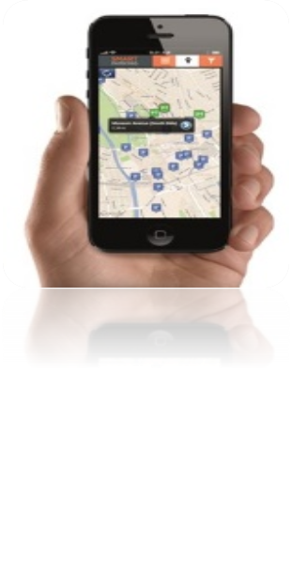
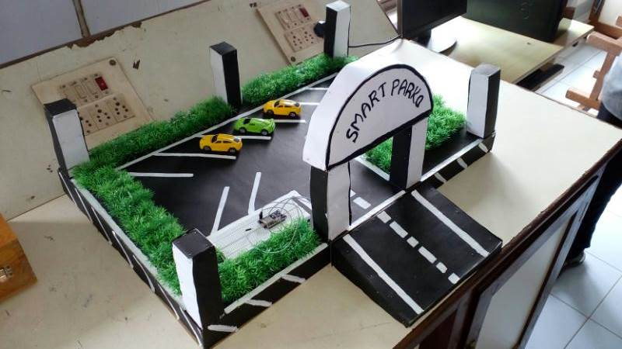

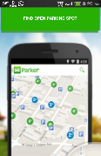
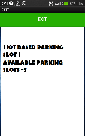
IoT BASED SMART PARKING SLOT FINDER “SMART-PARKO”
PRESENTED BY:T P M ABDULKAREEM (MKAOEEC106) , THAFSEERA K (MKAOEEC105), SAFEENA C (MKAOEEC088), and NAZNA AA (MKAOEEC114).
GUIDED BY: HARISH KUMAR CH (ASST. PROFESSOR),ECE
DEPARTMENT OF ELECTRONICS AND COMMUNICATION ENGINEERING
MES COLLEGE OF ENGINEERING, KUTTIPPURAM
System Overview
IoT (Internet Of Things)
IoT is a network of physical objects with embedded electronics that collect and share data through internet.
Using an android app user can find his nearby parking slot and number of free slots available. IR sensor detect car entering and leaving through parking stations and update slots via a server esp8266 node mcu Wi-Fi module.
imagine driving in the busy metropolitan area, you can just use your android mobile to locate a parking space.
Parking will be easier, faster, and more convenient.
PARKING SLOTS
IR SENSOR MODULE
ESP8266 NODE MCU
MODULE
SERVER
SMART PARKO ANDROID
APPLICATION
Figure 1. System Overview
Figure 4. iot concept
Prototype Model And Android Application
Future Scope
Parking payment service can be implemented
Parking slot suggestions can be provided through Android app
Advance parking slot booking service can be implemented.
Advantages
Parking will be ;
  Easier
  Faster
  More convenient.
Figure 2. Prototype model
Acknowledgments
DR. GOPAKUMAR A, HOD
MR. HARISH KUMAR CH, ASST PROFESSOR
MR. MANOJ CK, LAB INSTRUCTOR
.
References
Benenson, K. Martens and S. Birr. 2008. “Parkagent: An agent-based model of parking in the city,” Comput. Environ. Urban Syst. Vol. 32, no. 6
Figure 3. Android Application “SMART-PARKO”.

